Slide 1
Ultrasonic & Accelerometer
Team 4
Cyrus Tong Yap Boon (2102105)
Tan Jun Wei Kurt (2102402)
Walter Lay Zi Zheng (2101734)

Slide 2
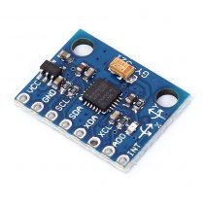
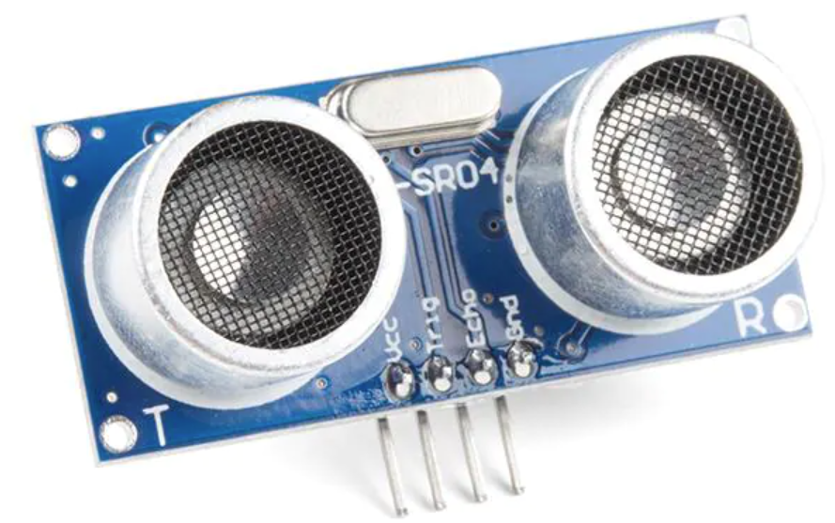
Overview
To detect the distance between the vehicle and the obstacle
Measure the height of the hump

Slide 3
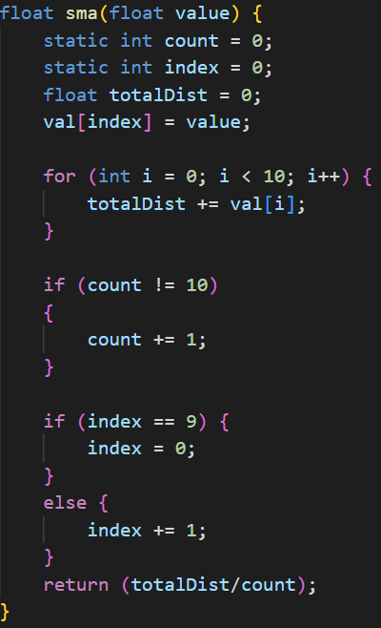
Simple Moving Average
Average reading from the past 10 measurements

Slide 4
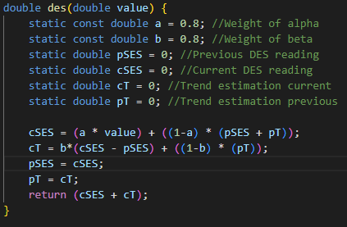
Double Exponential Smoothing
Exponentially decreasing weights for newest to oldest measurements
Newer readings are more relevant and given more weightage
Uses a weighted moving average and trend component

Slide 5
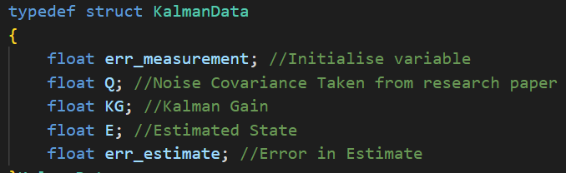
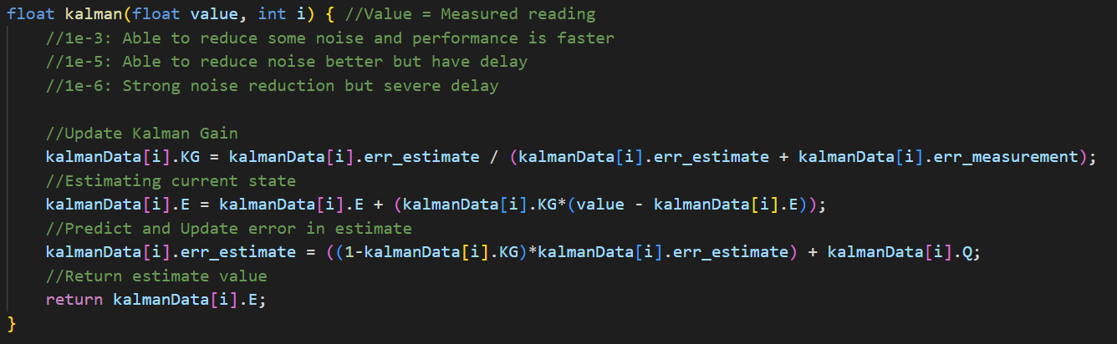
Kalman Filter

Slide 6
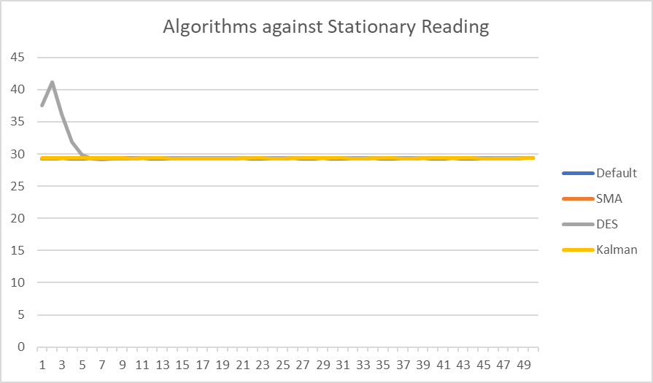
Algorithms Used
Taken 50 sample readings
Applied various algorithms
No severe fluctuations (Stable)
DES has a spike in initial readings

Slide 7
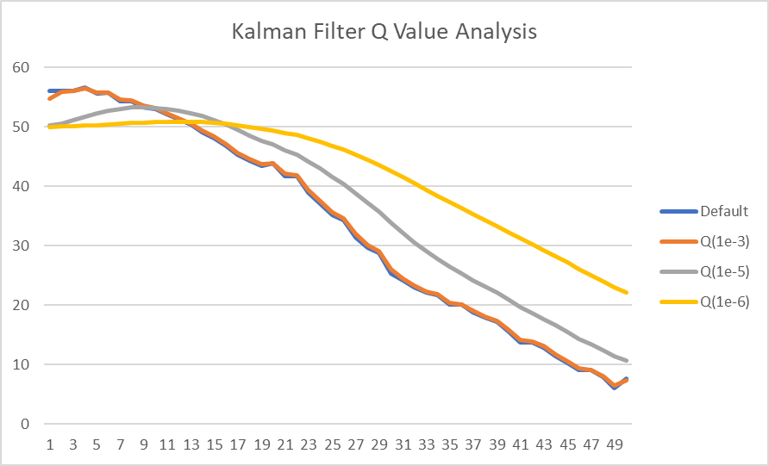
Comparison (Kalman Filter)
Sampled with several Noise Covariance (Q) referenced from a research paper
Q(1e-3) - Lesser noise reduction and lower latency
Q(1e-6) - Significant noise reduction but very delayed
Thus, we selected Q(1e-2) as the Noise Covariance

Slide 8
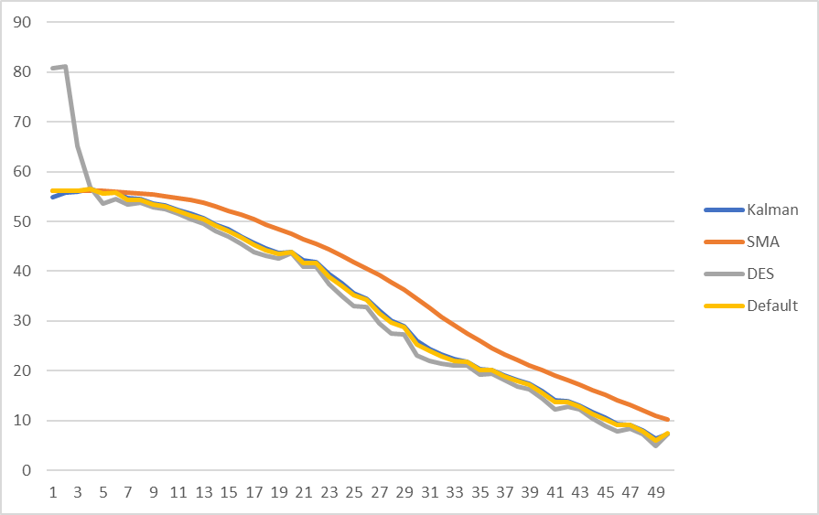
Comparison
DES have the initial spike before being able to stabilise
SMA despite providing a smooth graph, it has a significant delay
Kalman Filter provided some noise reduction having low latency

Slide 9
Accelerometer
The roll angle of the accelerometer is computing using the roll formula:
roll = atan2(y_Buff , z_Buff) * 57.3;
Where y_buff is the y acceleration while z_Buff is the z acceleration.
57.3 is obtained from 180 / PI to convert the angle into degrees
Source: https://wiki.dfrobot.com/How_to_Use_a_Three-Axis_Accelerometer_for_Tilt_Sensing

Slide 10
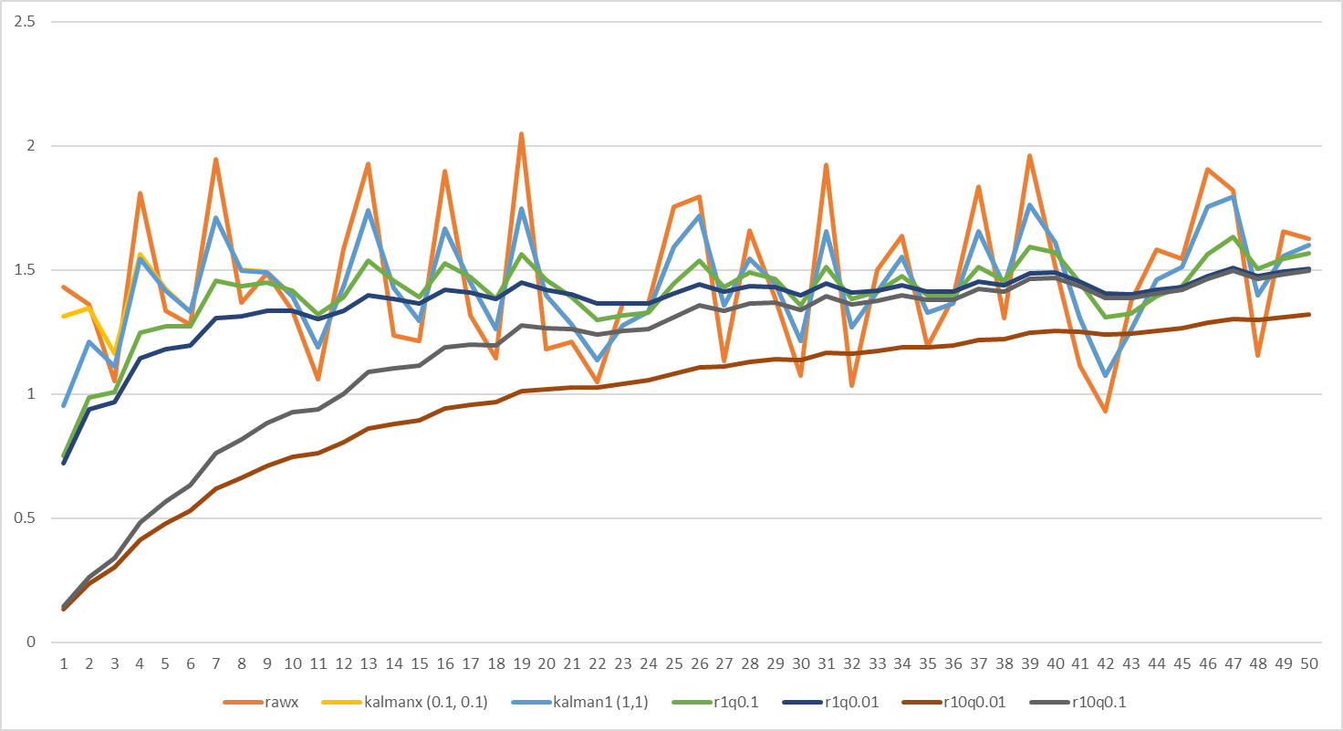
Accelerometer (Kalman Filter)

Slide 11
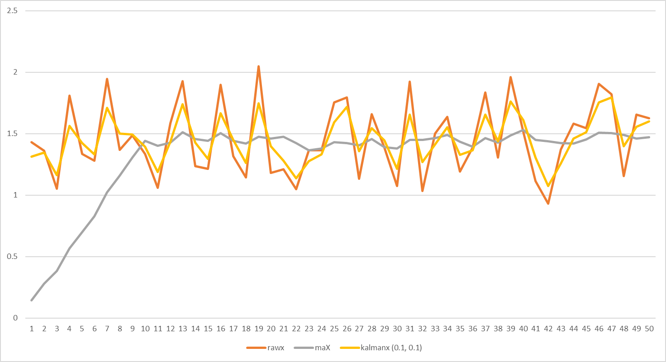
Accelerometer Filter (MA and Kalman)

Slide 12
Thank You

